Slide 1
SOC Final Project Improve UART Workload
111061560 吳俊鋌
111061534 陳 翀

Slide 2
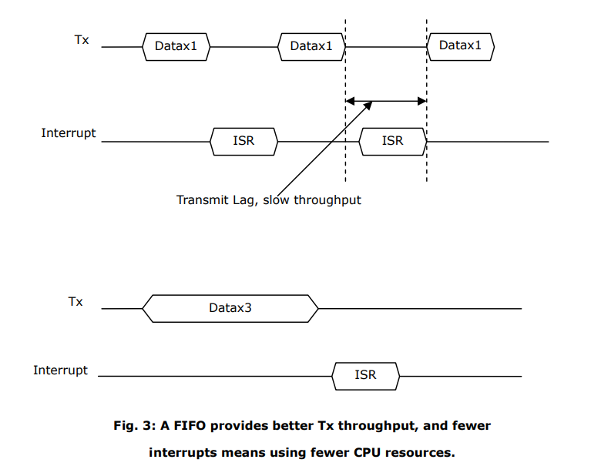
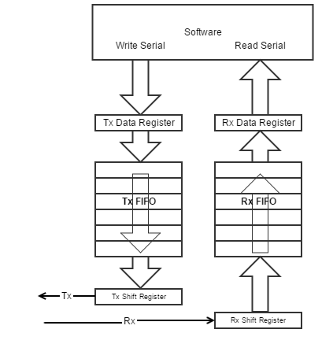
USE FIFO
Lab6’s origin design can’t transmit/receive data continuously.
Implement FIFO can enhance performance by decrease the number of Interrupt.

Slide 3
FIRMWARE
UART state register can detect Tx FIFO or Rx FIFO is full or not.
Store rx_data into Rx-FIFO until it is full.
Write Tx-FIFO data to tx_data until Tx-FIFO is empty.

